Slide 1


DESIGN AND FABRICATION OF A COMPACT , LIGHT WEIGHT
AND HIGH EFFICIENT ELECTRIC VEHICLE WITH
SOLAR POWER BACKUP
PRATHYUSHA ENGINEERING COLLEGE DEPARTMENT OF MECHANICAL ENGINEERING
Guided By :
Mr. P. SARMAJI KUMAR
ASSISTANT PROFESSOR
Team Members :
AKASH M
KAREM AKASH
HEMASHANKARAN M

Slide 2
OBJECTIVE
The goal of this project is to design and develop an electric vehicle (EV) with an integrated solar power backup system. And,
The primary objective of solar power backup into the electric vehicle is to enhance its range and reduce dependency on external charging infrastructure.

Slide 3
ABSTRACT
In this project, we have built an electric car in which the primary source of energy for the vehicle is derived from its battery, which can be recharged and the solar power backup system integrated into the EV provides an additional means of energy generation. The solar power backup system offers numerous advantages. Firstly, it enhances the vehicle's range by providing a supplementary source of energy. Additionally, the solar power backup system reduces the carbon footprint associated with EV charging, as it generates clean, renewable energy, thus contributing to a greener transportation ecosystem. Overall, the combination of an electric vehicle with a solar power backup system represents an innovative solution towards sustainable transportation. By harnessing the power of the sun, these vehicles offer extended range, reduced reliance on external charging infrastructure, and contribute to a cleaner environment. As solar technology advances and becomes more efficient, the integration of solar power into electric vehicles holds immense potential for a greener future.

Slide 4
COMPONENTS USED
HC-05 BLUETOOTH MODULE
L298N MOTOR DRIVER
ARDUINO UNO
YX850 POWER FAILURE AUTOMATIC SWITCHING BATTERY MODULE
SOLAR PANEL
BATTERY HOLDER
BATTERY HOLDER
SINGLE SHAFT BO MOTOR
65 MM MOTOR WHEEL
SOLAR BATTERY CHARGER
The list of components used are

Slide 5
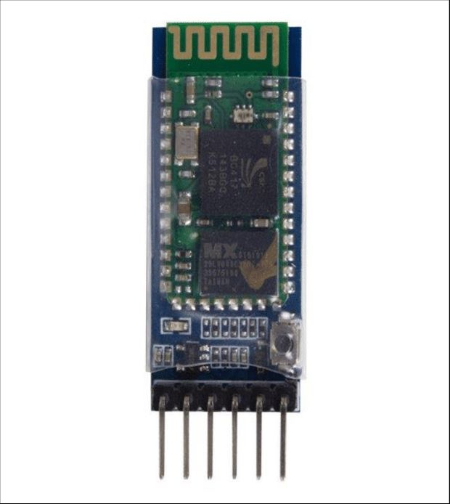
HC-05 BLUETOOTH MODULE :
This Bluetooth module is used for controlling our car from our mobile phone using an mobile application.
It receives Bluetooth signals from our controller and sends it to the arduino uno microcontroller which is responsible for our car movement

Slide 6
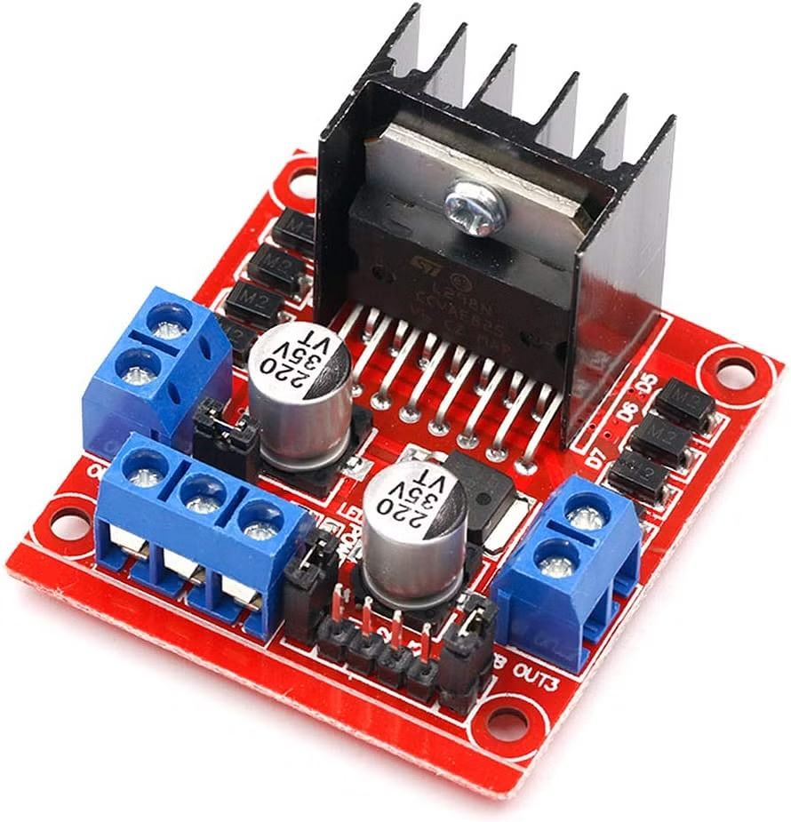
L298N MOTOR DRIVER :
This L298N motor driver is a module which allows speed and direction control of DC motors at the same time. The module can drive DC motors that have voltages between 5 and 35V, with a peak current up to 2A.
This driver controls our 4 single shaft BO motors placed on all sides.

Slide 7
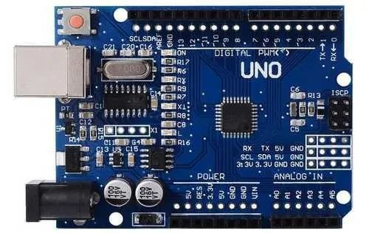
ARDUINO UNO :
This is a microcontroller board which is used for controlling electronics by programming.
In our project we used it for controlling the car directions. The code has been designed according to it and it gives signals to the L298N motor driver.

Slide 8
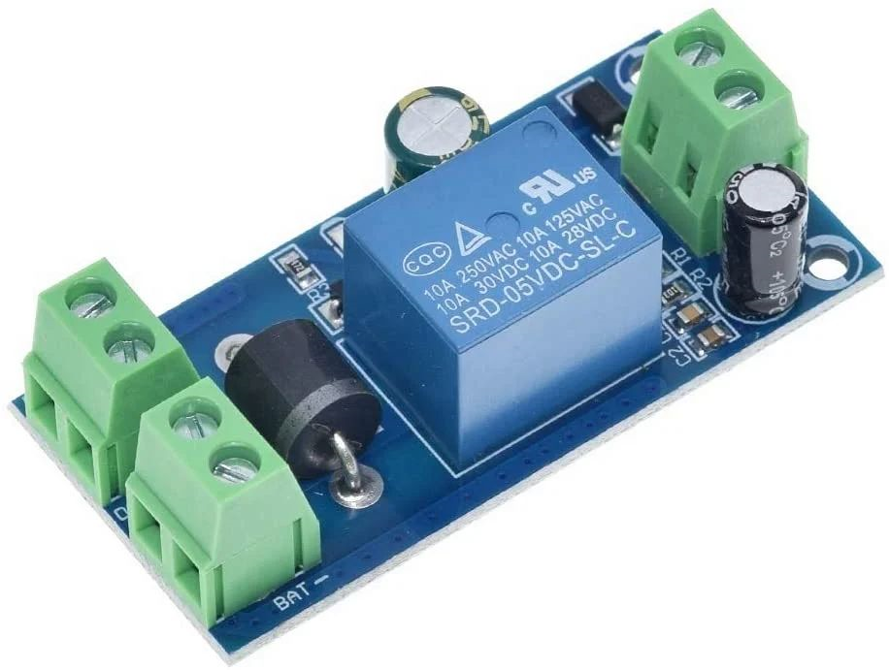
YX850 POWER FAILURE AUTOMATIC SWITCHING BATTERY MODULE :
This is a power failure module which provides continuous power supply in the time of power failure without interruption.
In our project we have used it for automatic switching of batteries from the primary battery to secondary battery when the primary battery loses it power.

Slide 9
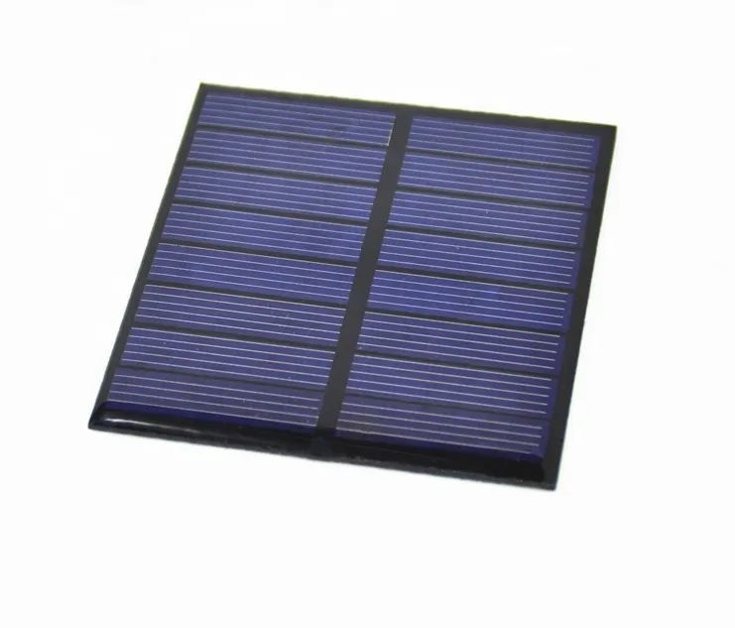
SOLAR PANEL :
The solar panel is used to charge the electronics by taking power from the sun.
In our project we have used it for charging our secondary battery as primary battery has separate charging options.

Slide 10
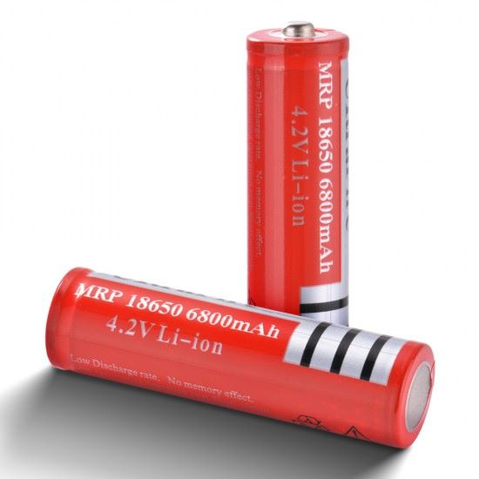
4.2 V 18650 LI ION BATTERY :
This is a rechargable battery which is used for supplying power to our motors to run the car.
It provides around 6000mAh of power which is quite enough to run four motor for some period of time.

Slide 11

SINGLE SHAFT BO MOTOR :
This is a light weight DC geared motor which gives good torque and rpm at lower voltages.
We have used four motors of this type in our project.

Slide 12
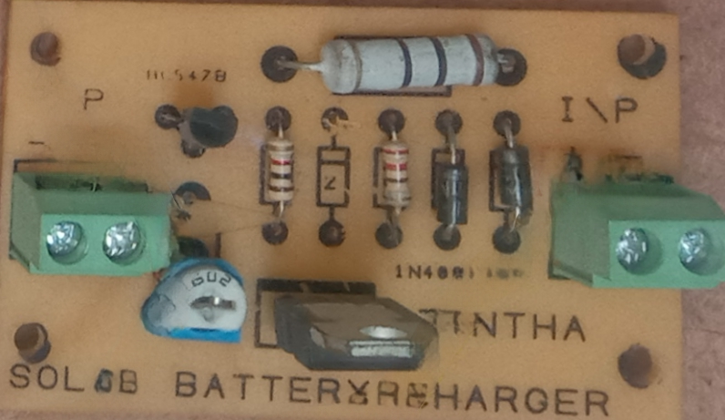
SOLAR BATTERY CHARGER :
This is a solar battery charger which recharges the battery power with the help of solar power.
The input and output wires from the solar panel are connected to this module and the voltage is regulated according to the battery

Slide 13
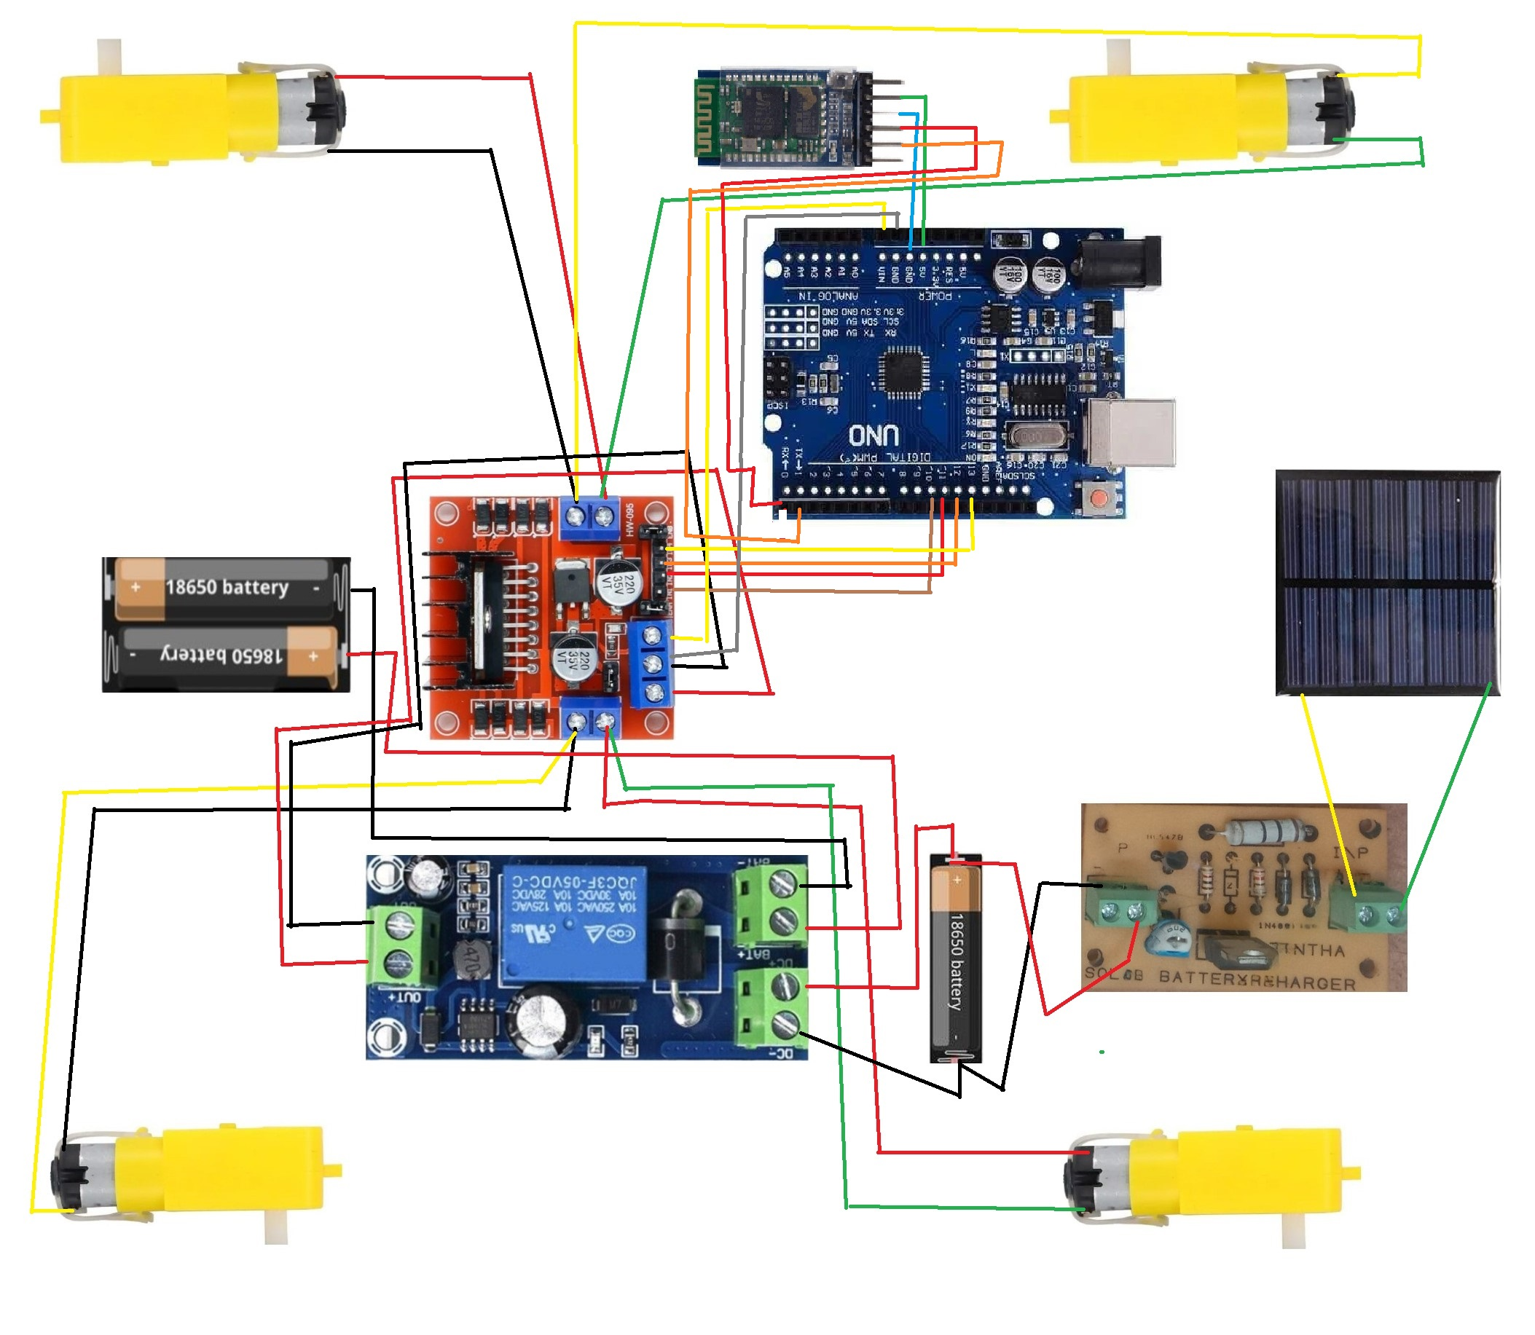
Schematic diagram:

Slide 14
Working :
In this project we have included several parts which play a major role in the working of the car with a solar power backup. The main objective is to run the car with a primary battery and supply a backup power with a secondary battery which may not provide as much power as the primary battery provides. For the primary battery we have used two 4.2V 18650 Li ion batteries which provide almost 9V of power which is enough to run four single shaft BO motors with 150RPM and one 4.2V 18650 Li ion battery as secondary battery.
Four BO motors are connected to the out ports of the L298N motor driver which controls the speed requirement of the motors. We use a YX850 Power Failure Automatic Switching Battery Module for automatic switching of power supply from primary battery to secondary battery without delay. Positives and negatives of the primary battery are connected to the power failure module and positive negative from the secondary battery is also connected to the power failure module since it has two input ports.

Slide 15
After the input connections the output power is drawn from the module to the L298N motor driver. We use a solar panel to recharge the secondary battery. The charging is regulated by a solar battery charger. The input from the solar panel is given to the solar battery charger and the output is provided to the battery from the solar battery charger to the secondary battery. This system uses an Arduino UNO microcontroller. It controls the motor speed and direction controls. The IN1, IN2, IN4, IN4 on the motor driver are the inputs required to run the motors. Those four ports are connected with the Arduino.
IN1 is connected with 10 on the Arduino, IN2 with 12, IN3 with13 and IN4 with 14, the connections were made with jumper wires. We have a program dumped in the arduino and the motors act according to it since the connections are made. The input to the arduino is given by connecting the 5V port of the motor driver to the VIN port on the arduino and the GND port of the arduino is connected to the GND port of the motor driver to provide grounding .
All connections are made and the car is ready to run but we need something to control our car motion. We use our mobile phone and an hc-05 Bluetooth module. The VCC pin of the bluetooth is connected to the 5V port of the arduino. The ground pin is connected to the GND port and grounded. The Tx pin which means transmitting pin is connected to the Tx port of the arduino and the Rx pin which means receiving pin is connected with the Rx pin on the arduino. All connections are made and we can control our car from our mobile phone with and application called “ BLUETOOTH RC CONTROLLER ”. It uses bluetooth signals to operate the car

Slide 16
CONCLUSION:
The design and fabrication of a high efficient electric vehicle with solar power backup offers a promising and sustainable solution for the transportation sector. It increases the range of the vehicle which plays a major role in electric vehicle. The Solar power backup enables EV owners to be more self-sufficient in terms of energy supply. The combination of EVs and solar energy brings numerous benefits, including reduced environmental impact, energy independence, cost savings, grid stabilization, and the potential for widespread adoption.

Slide 17
FUTURE ENHANCEMENTS:
We have planned to make a real size car with same idea setup of solar power backup.
The range and efficiency of the solar power will be increased.
In future we might employ wireless charging technologies, such as inductive or resonant charging, combined with solar power.
We plan to use lightweight materials. This would reduce energy consumption during driving.
Include most efficient charging and discharging strategies, ensuring optimal utilization of solar energy.

Slide 18
Thank you

